Slide 1
Section 5 Slides - Testing Grounds
<< Back To Section 4
These are the slides that accompany the Complete Unreal Developer Course.
See me develop the slides as I write the course…
Right click or Insert > Comment to comment, especially if you see a typo
The slides will update immediately as I change things.
Enjoy your stay!
Ben Tristem

Slide 2
Testing Grounds Introduction
4.12.5

Slide 3
In This Video…
Welcome, fresh start, new energy
Did you go back and modify Building Escape?
Most ambitious section yet
Bookmark the live Google Slides
Comment on the slides, especially typos
Come say hi at community.gamedev.tv

Slide 4
Testing Grounds GDD
4.12.5

Slide 5
In This Video…
The concept of the game
The rules of the game
Some of the asset requirements for the game
Identify possible technical challenges.

Slide 6
Concept
You’re a contestant in an entertainment game
Survive as many testing grounds as possible
Can you reach the end? Is there even an end?
You can use force or stealth to pass the grounds.

Slide 7
Rules
You can pass a testing ground undetected
If detected you must clear the area
Checkpoints save when you pass to a new area
If killed you return to the last checkpoint
You and enemies fight for same ammo resources
You’re scored on how many areas you pass.

Slide 8
Requirements
Testing ground landscape(s)
Unreal starter content + landscape tools
2 guns, and two ammo box types
A rigged humanoid character we can modify
Various SFX, samples from Gamemaster Audio
Other stuff I haven't thought of yet!

Slide 9
Potential Technical Challenges
Serialisation when saving
Checkpoint system architecture
Procedural generation of testing grounds
Creating a new skeletal animation.

Slide 10
How the Grounds Spawn
AI alert event
Last AI dead

Slide 11
Share your GDD
Write a post on the forum
Use the link in resources
Start a new topic
Write your GDD
Use markdown to format
Include sketches if you wish.

Slide 12
Using Git LFS (Large File Support)
4.12.5

Slide 13
In This Video…
The distinction between Git vs GitHub
Use Unreal’s toolbar & SourceTree
Enable Git Large File Support (LFS)
Setup on GitHub (no readme.md or initial commit)
Push to GitHub and share*
Warning: may take a while on slow broadband.
Notes:
View your push, deal with interface issues, CAN move files to LFS, use git gc to garbage collect.

Slide 14

Git & SourceTree
Client / SourceTree
GitHub.com
Staging
Repo
Stage
Commit
Push
File System
Pull

Slide 15
Setup your Project with Git LFS
Create using Epic Games Launcher
Connect to Source Control in Unreal
“Add Working Copy” to SourceTree
Enable LFS & track .uasset and .umap files
Setup a plain repository on www.GitHub.com
Connect SourceTree to GitHub & push.

Slide 16
Markdown & Marketing
4.12.5

Slide 17
In This Video…
Limitations of Unreal’s connection to GitHub
How to reset to previous commit to combine
Presenting your public GitHub page well
Using Markdown to enrich formatting.

Slide 18
Decorate & Share your Repo
Use Organisations / Teams as needed
Add a readme.md file and use MarkDown
Check visibility in an anonymous browser
NOTE: This all assumes you’re OK with it public!
Share using link in Resources for feedback
How else can you get feedback on your game?

Slide 19
Use git clean to Revert Project
4.12.5

Slide 20
In This Video…
Preview our work with AI characters
A way of renaming the last git commit
Revert to a previous state using Stash
Automatically clearing derived files with...
git clean -x -d -i
Use git clean -help for details

Slide 21
Git Comfortable
Make some changes to your project
For example move a cube, add a class, whatever
Close Unreal and commit using SourceTree
Reset master to previous commit
Run git clean -x -d -i
Open your project and check it has reverted.

Slide 22
First Person Character Overview
4.13.0

Slide 23
In This Video…
Upgrading my project to Unreal 4.13
An overview of the scene
How the First Person Character is composed
Adding a spiral staircase.

Slide 24
Add a Staircase
Overview the scene
Look at the First Person Character’s components
Add a curved staircase where indicated.

Slide 25
The Third Person Character
4.13.0

Slide 26
In This Video…
Add a third person character to the scene
Caution about tidying files at this stage
Add a navmesh, and check it’s continuous.

Slide 27
Add a Navmesh
Ensure it covers “up the stairs”
Preview with the P key
Share on the community site.

Slide 28
Introducing AI Behaviour Trees
4.13.0

Slide 29
In This Video…
Setup a Blueprint AI controller class
Behaviour Trees control AI execution flow
Blackboard holds AI instance data
How to associate a behaviour tree with an AI
Testing that our behavior tree is running.

Slide 30
Get NPC_AI_BP Class Working
Create a new Blueprint class
We can re-parent to C++ later if needed
Make this the default class for placed AI
On Begin Play test by printing.

Slide 31
Introducing AI Blackboard Data
4.13.0

Slide 32
In This Video…
Blackboard data is like member variables in code
Using blackboard data to set patrol points
Practice setting blackboard values in Blueprint
Test simple AI patrol behaviour.

Slide 33
Target Points and Patrol Routes
4.13.0

Slide 34
In This Video…
Add a variable to the NPC’s blueprint
How to make a variable an array in blueprint
Introducing Target Point actors
Using target points to specify patrol routes.

Slide 35
Add Another Patrolling Soldier
Add another AI character
Add a new Target Point up the stairs
Make the two actors share this point only
Add a couple of new points just for the new guy.

Slide 36
Using Any Actor for Waypoints
4.13.0

Slide 37
In This Video…
Actors are more general than target points
How to select an actor from another actor
Getting the AI Controller to set Blackboard data
Testing our characters go to a set waypoint.

Slide 38
Get AI Going to First Targets
Find index 0 from the array
Set the Waypoint Blackboard key
Check both guards to go their first waypoint.

Slide 39
Options for Grouping Actors
4.13.0

Slide 40
In This Video…
Use layers (usually used for visibility)
Use groups as a simple multi-select tool
Use tags, can be flexible but easy to forget
Use a parent Empty Actor, or a Folder
Group on game object (e.g. array on NPC)
The key is to know the pros and cons.

Slide 41
Explain a Grouping Choice
Pick a grouping choice for patrol points
Don’t worry about how we’re already doing things
Click “Lecture Discussions” in Resources
Share your thoughts with others
I’ll pick one and carry-on with that
The purpose is to think about it.

Slide 42
Blueprint Behaviour Tree Tasks
4.13.0

Slide 43
In This Video…
How to use Blackboard Key Selector variables
Creating new Tasks in Behaviour Trees
Pseudocode programming in Blueprint
How to use the Execute AI node
How to use the Finish Execute node.

Slide 44
Set Next Waypoint
Get the functionality we had back
Just go to the first waypoint
You can assume the index initialises to 0.

Slide 45
Modular Arithmetic & Cycles
4.13.0

Slide 46
In This Video…

Slide 47
About the Modulus Operator
The % operator is the REMAINDER of a division
1%3 = 0 + 1/3 so the modulus is 1
2%3 = 0 + 2/3 so the modulus is 2
3%3 = 1 + 0/3 so the modulus is 0
5%3 = 1 + 2/3 so the modulus is 2
7%3 = 2 + 1/3 so the modulus is 1

Slide 48
Using Modulus to Cycle
15%8
8%8
7
0
14%8
6
1
9%8
13%8
5
2
10%8
4
3
12%8
11%8

Slide 49
What’s the bug in the closet?
If we store the index value...
Eventually it will go out of range (e.g at 2^32)
Usually this will cause the counter to “skip”
Solution: just store the result.

Slide 50
Get the Cycling Working
Write our final Blueprint function
Use Set Blackboard Value as Int node
Test the AI cycles between waypoints
Celebrate, and share your solution.

Slide 51
Performance Profiling 101
4.13.0

Slide 52
In This Video…
The first rule of performance: “profile first”
Access profiler from Window > Developer Tools
Choose Session Front End
Select your running game session
Choose Profiler tab, and hit Data Preview
Search for your function and double-click.

Slide 53
Calculate Your Max Load
Estimate max load value for each function
Find the slowest of the 5 or 6 functions you find
Share the value and your working on the forum
Also include a screenshot of your profiler
MaxLoad = Max* Calls %.

Slide 54
C++ AI Behaviour Tree Tasks
4.13.0

Slide 55
How to Create C++ AI Tasks in Unreal
Add “AIModule” and “GameplayTasks” to build
Inherit C++ class from UBTTaskNode
Override ExecuteTask()
Return EBTNodeResult::Succeeded;
Don’t try and extend in Blueprint
Use Blueprint XOR C++ for a given task.

Slide 56
Reading Blackboard Data in C++
4.13.0

Slide 57
In This Video…
Expose a blackboard key selector in C++
#include “BehaviorTree/BlackboardComponent.h”
OwnerComp.GetBlackboardComponent()
Use GetValueAsInt() etc to get the value
You can now access blackboard data in C++.

Slide 58
Get the Index
Finish the line of code to get the index.

Slide 59
The Consequences of Inheritance
4.13.0

Slide 60
In This Video…
We have coupled our AI ChooseNextWaypoint task to the Third Person Character.
We have also specialised our Blueprint class with a variable, PatrolPoints.
These dependencies are undesirable, but we will proceed with our conversion.

Slide 61
Create a PatrollingGuard Class
Inherit from TP_ThirdPersonCharacter
Add an array of Actor pointers variable
Make it an appropriate UPROPERTY
Re-parent your ThirdPersonCharacter Blueprint
Check you can assign to this new C++ variable
NOTE: This is bad practice, as we’ll see later.

Slide 62
Converting Blueprint to C++
4.13.0

Slide 63
In This Video…
OwnerComp.GetAIOwner() to get AI Controller
If you’re casting, you’re probably coupling
Use .Num() to get number of elements in TArray
Use TODO for reminders, to help you FOCUS
FOCUS = Follow One Course Until Successful.

Slide 64
Finish the C++ Patrolling
Use OwnerComp.GetAIOwner() to get controller
Use #include where necessary, but consciously
Use the same algorithm as in Blueprint
Test the patrolling works
Clean-up unused Blueprint.

Slide 65
Composition over Inheritance
4.13.1

Slide 66
In This Video…
We created PatrollingGuard by inheritance
How about if we want a patrolling tank?
Another option is to use an actor component
This is an age-old debate
Let’s get some real-world experience of the two
Convert to a component model.

Slide 67
Create PatrolRoute Component
Create an Actor Component
Move the PatrolPoints array to the component
Add the new component to the guard’s BP
Get the patrol points from the component
Don’t bother deleting the PatrollingGuard class.

Slide 68
How to Delete a C++ Class
4.13.1

Slide 69
In This Video…
Yes it should be easier than this, tell Epic!
How to remove CPP files from browser in Unreal
The process for deleting C++ classes.

Slide 70
Remove PatrollingGuard Class
Close Unreal and Visual Studio
Remove .cpp and .h files from your disk (not in VS)
Clear derived files (git clean -x -d -i if committed)
Generate the Visual Studio project files
Re-open Unreal!

Slide 71
Instanced Materials
4.13.1

Slide 72
In This Video…
Also called Material Instances
These allow modification with little overhead
How to create an instanced material.

Slide 73
Colour the Other Guard
Create another material instance
Check the Reference Viewer
Set it a different colour
Apply to a 2nd guard
Bonus: Add a new parameter and tweak
Share your creations with us!

Slide 74
Introducing AI Perception
4.13.1

Slide 75
In This Video…
Use AI Perception, it’s newer than Pawn Sensing
How to add AI Perception to your controller
Use the apostrophe key ‘ to enable AI debug
Remember Shift + F1, F8, F11 etc.

Slide 76
Tweak Your AI Perception Radius
Practice visualising the AI
Shift + F1 to get the mouse
Use F11 for fullscreen
Aim at AI with cross hair then...
...use apostrophe key ‘ for AI debug overlay.

Slide 77
OnTargetPerceptionUpdated Event
4.13.1

Slide 78
In This Video…
Use the On Target Perception Updated event
This reports the actor sensed
And the class of the sense (e.g. sight, hearing)
How to setup perception events.

Slide 79
Report Perception Events
Wire the required blueprint
Report in format “guard x <perception class> y”
Crtl key makes hand icon, allows node dragging.

Slide 80
AI Hearing Perception in Unreal
4.13.1

Slide 81
In This Video…
Hearing is a sense that compliments sight
How to set up AI Perception hearing sense
How to get hearing perception to trigger
Making your actor create a noise.

Slide 82
Setup a Hearing Sense
Add a 2nd sense to the AI controller
Make this of type hearing
Bonus: report hearing events*
*may require a web search, good practice.

Slide 83
The Animation Starter Pack
4.13.1

Slide 84
In This Video…
The skeleton comprises the bones
Over the skeleton lays a skeletal mesh
Each vertex of the mesh connects to bone(s)
The animation tells the bones how to move
The bones tell the mesh how to move
The Animation BP controls the animations.

Slide 85
Animation Sequence in Context
AI Controller
Character
Animation BP
Behaviour Tree
Patrol Route
Graph
Movement
Animation
Skeletal Mesh
Skeleton

Slide 86
Import & Explore
Claim Animation Starter Pack for free
Add to Testing Grounds project
Explore the Animation Sequences
Commit and upload to Git LFS.

Slide 87
Changing a Character’s Animation
4.13.1

Slide 88
In This Video…
How to change a mesh’s animation class
Matching the animation’s mesh to…
… the mesh selected on the character
You can apply instance changes to blueprint
However be careful what you take with you
Solving “can’t save… graph is linked” error.

Slide 89
Animation Sequence Revisited
AI Controller
Character
Animation BP
Behaviour Tree
Patrol Route
Graph
Animation
path finding
Movement
Skeleton
Skeletal Mesh

Slide 90
Why isn’t the character animating?
Re-watch the previous video if required
Think through the steps
See if you can find the cause
Test by making a small change (one setting)
Let us know your thinking process
Spend approx 20 mins on this I suggest.

Slide 91
Customising a Character Blueprint
4.13.1

Slide 92
In This Video…
You can start with a off-the-shelf blueprint
We can then add our reusable components
Another way of getting our desired character.

Slide 93
Create your new Blueprint
Ensure your ASP based guard works
Make sure you feel happy with why
Save your & close your project.

Slide 94
Sub Behaviour Trees
4.13.1

Slide 95
In This Video…
Behaviour trees can get complex
We want to keep a consistent level of abstraction
Behaviour trees can run “sub” trees
This helps us organise our project.

Slide 96
Make some Interesting Behaviour
Play with sub-behaviour trees
Share your top-level, and one or two next level
Optionally share a short video or animated GIF
Have fun, get creative.

Slide 97
Talking Head - Introducing Sam
4.13.1

Slide 98
In This Video…
Congratulations on getting this far in the course.
Recapping the AI work we have done so far.
Introducing the new instructor for the section: Sam.

Slide 99
Refactoring Superpowers
4.13.1

Slide 100
In This Video…
Why refactoring is so important.
Refactor skills give you the edge.
What’s coming up in the next lectures.

Slide 101
Target Structure
Levels
Level_1…
NPC
Animations
Character
AI
Player
Geometry
Weapons

Slide 102
Clean-up Your Folders
Check references, or delete and read warning
“Fix-up redirectors” if you’re having issues
Create a folder structure that makes sense to you
Remember you can filter by type
So you may as well add some other value
I suggest something similar to Epic’s structure.

Slide 103
Changes Sam Made - Part 1
Remember you can show redirectors with Content Browser > Filters > Other Filters > Show Redirectors.
Make new Levels folder in Unreal (in this case it overlaps with the filter options)
Move FirstPersonExampleMap from FirstPersonCPP/Maps to Levels
Delete any other maps from the FirstPersonCPP/Maps folder
Delete the FirstPersonCPP/Maps folder in Unreal & your file system
Create Trash folder in Unreal
Move ThirdPersonCPP/Blueprints/PatrollingGuard to Trash folder
Fix-up redirectors and delete ThirdPersonCPP folder, & in your file system
Move all meshes from ThirdPerson/Meshes to Geometry/Meshes
Delete ThirdPerson folder in Unreal, and in file system
Move Mannequin folder into Trash folder
Create FirstPerson/Behaviour folder
Continued on next slide...

Slide 104
Changes Sam Made - Part 2
Move blueprints from FirstPersonCPP/Blueprints to FirstPerson/Behaviour
Fix-up redirectors & delete FirstPersonCPP in Unreal and file system
Rename FirstPerson folder to Player
Delete FirstPerson folder in file system
Create new NPC folder, and NPC/AI sub-folder
Move all files from Blueprints to NPC/AI (remember to fix-up redirectors)
Delete Blueprints folder in Unreal and on disc
Create NPC/Animations folder
Move all animations from AnimStarterPack to NPC/Animations**
Create NPC/Character folder and move AnimStarterPack/Ue4ASP_Character into it
Move the Showcase level to Trash
* if you have a problem with this stage, try quitting all Unreal Engine tasks in your OS, or rebooting
** leave the Ue4ASP_Character and the Showcase level (if you still have it)
Continued on next slide...

Slide 105
Changes Sam Made - Part 3
Move all three folders in AnimStarterPack/UE4_Mannequin to NPC/Character
Fix-up redirectors and delete AnimStarterPack in Unreal, and on disc
Create Weapons folder, and move Player>FPWeapon into it
Delete Player/FPWeapon in file system
Also in the file system delete the following in Content: Manneqin, Collections, Developers

Slide 106
Renaming & Moving CPP
4.13.1

Slide 107
In This Video…
Renaming CPP files.
How to deal with renaming blueprint parents.
Refactor class names in CPP.
Updating .generated.h files.

Slide 108
CPP Refactor Process
Are any blueprints based of this?
If so, copy outside our directory while renaming.
Rename/move the file.
Find and replace the file path.
Find and replace the class name.
Copy back, reparent, delete.

Slide 109
Reorganise Your CPP
Make the structure match your contents.
Watch out for dependencies in blueprint.
Make sure you regenerate your project files.
Try to debug your own error messages.

Slide 110
Solution: Renaming & Moving CPP
4.13.1

Slide 111
In This Video…
Repeating the renaming process.
Finishing our refactor.
Fixing CDO Constructor errors.

Slide 112
Holding a Gun with Skeletal Sockets
4.13.1

Slide 113
In This Video…
Reading existing source code for hints.
Creating a socket on a skeletal mesh.
Parenting a gun to that socket.
Removing unused assets.

Slide 114
Copy The FirstPersonCharacter
Read the constructor and BeginPlay.
Can you see how the gun is set up?
What does this tell us about the skeleton?
Can you replicate the setup on the 3rd person?

Slide 115
Understanding Animation Blueprints
4.13.1

Slide 116
In This Video…
The major components.
How to preview animations.
Definition of an animation and pose.
Understanding the AnimGraph.
Playing a custom animation.

Slide 117
Dance Monkey Dance!
Play an animation in the preview.
Use only the AnimGraph to achieve this.
HINT: Try dragging from the animation pane.

Slide 118
Creating Animation State Machines
4.13.1

Slide 119
In This Video…
Why state machines?
What are state machines?
What’s inside a UE4 state?
How to add transitions.
Adding a shooting state.

Slide 120
N
N
N
Crouch?
Run?
Jump?
Start
Y
Y
Y
Play Idle
Play Crouch
Play Run
Play Jump
N
Ground?
Y

Slide 121
A State Machine
Idle
Jumping
Crouch
Run

Slide 122
Add a shooting state
Use the iron-sight shooting animation.
Create a new state from idle.
Add a boolean to trigger shooting.
Set the transition conditions.
Does it work?

Slide 123
Movement Blend Spaces
4.13.1

Slide 124
In This Video…
What is a blend space?
How to create a movement blend space.
Examining the existing Jog blend space.
Replicating for Ironsights.

Slide 125
Replicate the Jog Blend Space
What are the axes?
Position the animations correctly.
Test in the scene.
Does it look right in all directions.

Slide 126
Offset Animations
4.13.1

Slide 127
In This Video…
Creating an offset animation.
Applying an offset to a base.
Conditional blend nodes.

Slide 128
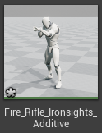
-
=
+
=
+
=

Slide 129

Base
Mesh-space
Bone-local

Slide 130
Create Other Offsets
Make a down and centre offset.
Use a conditional node to choose.
Make the variable that controls it a float.
When float < -45 should look down.
When > 45 should look up.
Otherwise look in the middle.

Slide 131
Aiming Blend Spaces Offsets
4.13.1

Slide 132
In This Video…
Aim offset assets.
1D vs 2D Aim offsets.
Editing an existing animation sequence.

Slide 133
Create the Aim Offset
Add the offsets into the aim graph.
Check the preview.
Try to add to the animation blueprint.
Can you figure out how?

Slide 134
Rotating with SetFocalPoint()
4.13.1

Slide 135
In This Video…
Revising Behaviour Tree tasks.
Making our character face us.
Using AIController’s SetFocalPoint()

Slide 136
Create a FocusAtPoint Task
Any sensible name.
Public blackboard key for point.
Should set the AI focus.
Then action should finish.
Test it by setting a location in the blackboard.

Slide 137
Character Movement vs Rotation
4.13.1

Slide 138
In This Video…
More code reading.
Jumping between files in Visual Studio.
Difference between movement and rotation.
Mapping out complex systems.

Slide 139
Character Rotation
Get desired rotation
Behaviour Tree
Controller
UCharMC
Focus on point
Update rotation
Update rotation
Get control
rotation
AIController
PlayerCtrlr
Add yaw
(via Pawn)
Animation BP
Input
FPCharacter
Move mouse

Slide 140
Map out the Character Movement
Start from Behaviour tree.
Where does it lead?
Also try working back from the Animation BP
Can you find where they meet?
What about starting from Input?

Slide 141
Character Movement
Set Velocity
Behaviour Tree
UCharMC
APawn
Move to point
Run in direction
UPawnMC
Get Velocity
AIController
UNavMC
Move to point
Move in direction
Move in direction
Animation BP
Input
FPCharacter
Forward key pressed

Slide 142
Control Rotation for Aim
4.13.1

Slide 143
In This Video…
Getting the control rotation.
Focus Actor vs Focal Point
Splitting rotators and setting pitch.
Controlling Animation BP properties.

Slide 144
Focus on Actor Instead of Point
Get the correct type in FocusAtActor.
Change the blackboard property.
Set the correct type in AIController.
Why do we need to focus on actor?

Slide 145
Behaviour Tree Decorators
4.13.1

Slide 146
In This Video…
Creating a decorator.
Sequence vs Select nodes.
Aborting decorators early.
Clearing blackboard keys from blueprint.
Patrolling, agro and following.

Slide 147
Set and Clear Enemy
Update the AI Blueprint.
When enemy sensed, set Enemy.
When enemy lost, clear Enemy.
Try splitting the stimulus to help.
Are there any problems with the behaviour?

Slide 148
Behaviour Tree Services
4.13.1

Slide 149
In This Video…
Using decorators vs services.
Creating a service.
Deeper into behaviour tree states.
How to implement suspicion.
Giving our character breathing space.
Comparing BP Validity and NULL.

Slide 150
Create a Suspicion Behaviour
Use a new blackboard variable.
E.g. LastSeenLocation.
Set with a service.
Then set move to that location.
Unset when visited.
Any tweaks to make it more natural?

Slide 151
Tweaking AI Behaviour
4.13.1

Slide 152
In This Video…
Preventing Behaviour Tree flicker.
Creating mutually exclusive states.

Slide 153
Make All States Mutually Exclusive
Enemy should give us breathing space.
Shouldn’t be suspicious if can chase.
Shouldn’t chase if we are already close.

Slide 154
Debugging AI Behaviour
4.13.1

Slide 155
In This Video…
Viewing behaviour while playing.
Using tags on Actors.
Revising interrupting tasks.
Adding in multiple actors.

Slide 156
Debug Two Enemies
Put two enemies in the scene.
Observe the behaviour.
What happens?
Can you think of a fix?

Slide 157
Refactoring to a Gun Actor
4.13.1

Slide 158
In This Video…
Create a Gun actor.
Move the firing code over.
Revising refactoring.

Slide 159
Do the Refactor
Create an new C++ class.
Move the default sub objects over.
Move the OnFire() code.
What else needs to move for this to work?
It won’t work but make it compile.

Slide 160
Attaching Actors to Components
4.13.1

Slide 161
In This Video…
Revise spawning child actors.
Attaching actors to sub-components.
Attachment rule to sockets.

Slide 162
Spawn and Attach
Create a variable for the gun blueprint.
Spawn an instance of this.
Attach the instance to the grip socket.
What else needs connecting?

Slide 163
Configuring the Gun
4.13.1

Slide 164
In This Video…
Playing montage animations.
Connecting to actors in code.
Finishing our refactor.

Slide 165
Finish Connecting
Can you make the gun fire again?
Do they fire in the right direction?
Make the projectiles smaller.

Slide 166
Moving Files from LFS to Git
4.13.1

Slide 167
In This Video…
The pros and cons of LFS.
How to move files from LFS.
Tracking folder instead of extensions.
Where tracking happens.

Slide 168
How to Remove from LFS
Edit tracked files.
git rm --cached -r .
git add .

Slide 169
Re-track Your Files
Move everything into a static folder.
Leave one blueprint out.
Edit tracking.
git lfs track Content/Static
git rm --cached -r .
git add .

Slide 170
To LFS or Not to LFS?
4.13.1

Slide 171
In This Video…
The pros and cons of LFS.
Organising your project for clarity.
How to deal with .umap assets.

Slide 172
Re-organise Your Project
Investigate each sub folder.
Which assets are you likely to change?
Are they an acceptable size?
Move them into the two folders.
Ensure you clean up on disk too.
Update the git index.

Slide 173
Child Actor Components
4.13.1

Slide 174
In This Video…
Previewing the gun with the skeleton.
Positioning the gun.
Child actors with Blueprint.
Using Child Actor Components.

Slide 175
Add a Gun to the AI
Use a Child Actor component.
Make sure it’s visible in game.
Position the gun correctly.

Slide 176
Introduction to Inverse Kinematics
4.13.1

Slide 177
In This Video…
Local vs component-space poses.
Understanding bone-space.
The principles of IK.
End effectors and Joint targets.
Mapping to the Two Bone IK node.

Slide 178
IK Fundamentals
X

Slide 179
IK Fundamentals
X
End Effector

Slide 180
IK Fundamentals
X
X
Joint Target

Slide 181
How Does It Map?
Create a Two Bone IK node
Take a look at the properties.
Can you guess which properties map to which?

Slide 182
Inverse Kinematics with Animations
4.13.1

Slide 183
In This Video…
Using the Two Bone IK node.
Effectors vs Joint targets

Slide 184
Set-up the AI IK
Create the Two Bone IK.
Link the main bone.
Set up the relative effector and joint.

Slide 185
Comparing Blueprints with Diffs
4.13.2

Slide 186
In This Video…
Using UE4 built-in version control.
Diffing blueprints.
LFS vs Git assets in editor.

Slide 187
What Changes Can You Find?
Dig through the commits.
What cool looking diffs can you find?
Share with the community.
What happens to LFS assets?
How could you diff them?

Slide 188
Boolean Blending for Aim States
4.13.2

Slide 189
In This Video…
Boolean blending in Unreal.
Setting variables in animation BP.
Making the AI aim.

Slide 190
Connect to Focus
Complete the Jogging state.
Set a variable in the character.
Pull that in the animation.
Set when focus is set.

Slide 191
Adding Firing Animations
4.13.2

Slide 192
In This Video…
When to use additive identities.
Blending additive animations.
Creating an additive firing animation.
Controlling firing from the AI.

Slide 193
Make an Additive Fire
Make a copy of the fire animation.
Change it to being additive.
Plug in to the conditional.
Connect up to the AI.

Slide 194
Animation Notify Events
4.13.2

Slide 195
In This Video…
Synchronising sound and animation.
Creating custom notify events.
Hooking up our gun trigger to AI.

Slide 196
Hook up the Event
Create a fire notify.
Expose the gun function to BP.
Create a Fire function in the character.

Slide 197
Taking Damage in Blueprint
4.13.2

Slide 198
In This Video…
Applying damage from a projectile.
Taking damage in a BP character.
Detaching a controller from a Pawn.

Slide 199
Create the Damage System
Apply damage on hit.
Update health in the character BP.
When dead, detach from the controller.

Slide 200
Death Animations and Refactors
4.13.2

Slide 201
In This Video…
Revision of BP refactoring.
Making our Animation BP clean.
Death animations on the AI.

Slide 202
Refactor the Animation BP!
Replicate the death animation.
Sort out our event graph.
Abstract into functions.
Abstract repeated or shared code.

Slide 203
Switching 1st and 3rd Person
4.13.2

Slide 204
In This Video…
Swapping out a 1st to 3rd person character.
Wrapping rotations.

Slide 205
Debug and Fix Rotation
Use some print statement.
What’s happening?
Can you create an elegant fix?

Slide 206
Owner Invisible Meshes
4.13.2

Slide 207
In This Video…
Own See vs Owner no see meshes.
Why 1st person Meshes.
Hooking up Fire input in TPCharacter.

Slide 208
Enable Firing
Handle the fire input in TPCharacter.
What should this do?
Make sure the animation works too.

Slide 209
Separating Firing from Gun Meshes
4.13.2

Slide 210
In This Video…
Why we need two gun meshes.
Creating Blueprint components.
Scene components vs Actor components.
Camera rotation with control rotation.

Slide 211
Create a Firing BP Component
Use a scene component to have a transform.
Just a fire method.
Use it to spawn a projectile.
Set the transform from the components location.
Position and test.

Slide 212
Aiming Our 1st Person Camera
4.13.2

Slide 213
In This Video…
Local vs Global rotation.
UE4 optimizations for unpossesed characters.

Slide 214
Make The Camera Rotate On Tick
Update the camera pitch.
Should you use local or global?

Slide 215
Architecture of Infinite Runners
4.13.2

Slide 216
In This Video…
Using the Arrow component.
How to architect an infinite runner.
Overview of how we want our levels to work.

Slide 217
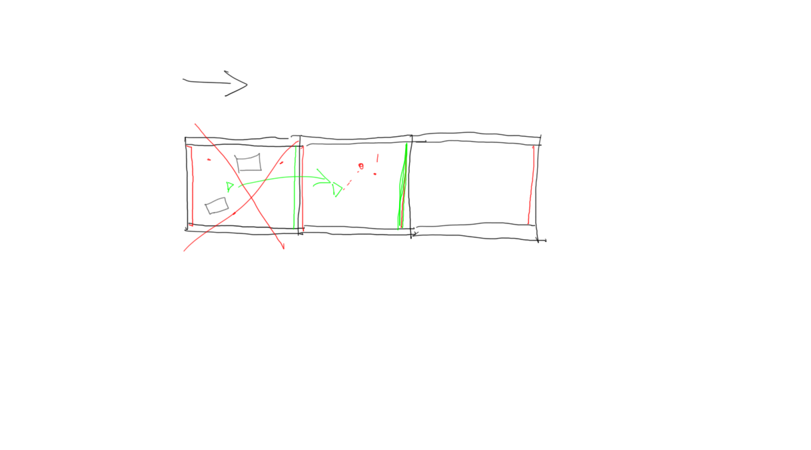

Slide 218
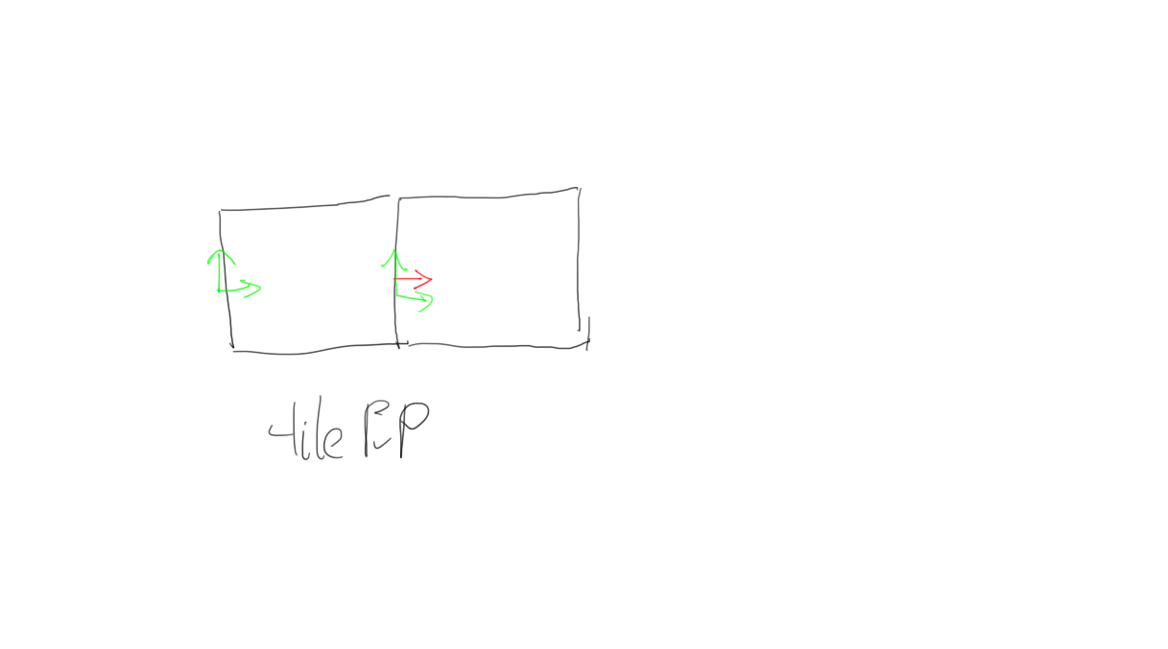

Slide 219
Create the Tile BP
Use the existing terrain to start.
Add an arrow for the attach point.
Add a function for getting the attach location.
Ensure the centre of the tile is at the left edge.

Slide 220
Spawning Terrain in the GameMode
4.13.2

Slide 221
In This Video…
GameMode BP vs Level BP
Creating a blueprint GameMode
How to spawn tiled terrain.
Using a blueprint for-loop.

Slide 222
Spawn a Series of Tiles
Create a variable for the transform.
Set an initial transform.
Update the transform after spawning.
Refactor your code.

Slide 223
Level Gating for Testing Grounds
4.13.2

Slide 224
In This Video…
Why we need level gating.
Our approach to gating.
Enabling/disabling collisions.

Slide 225
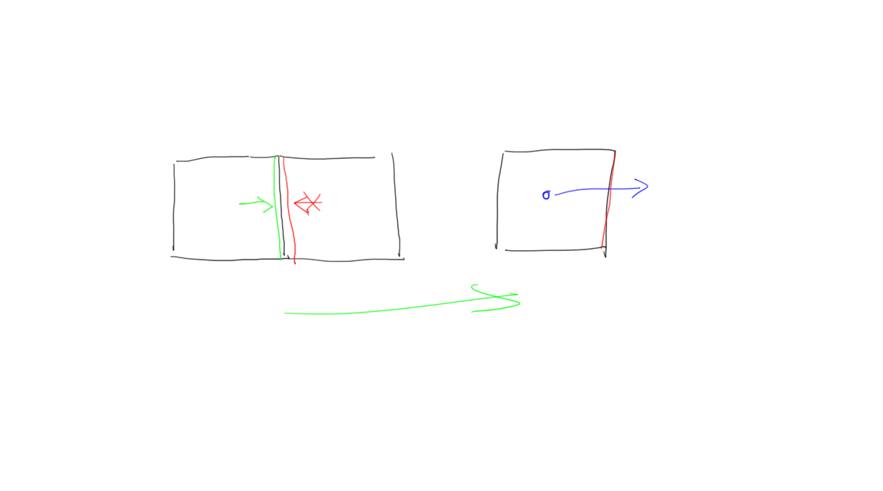

Slide 226
Lock on Exit
Create a new locking function.
Create a collision box component.
When leaving box, lock the level.

Slide 227
Swapping Materials in Blueprint
4.13.2

Slide 228
In This Video…
Creating material instances.
Exposing material parameters.
Swapping materials in blueprint.
Adding affordance to our barriers.

Slide 229
Red and Green Barriers
Create two material instances.
Setup the correct opacity and colour.
Replace the materials on lock and unlock.

Slide 230
Garbage Collecting Previous Tiles
4.13.2

Slide 231
In This Video…
When to delete previous tiles.
How to get hold of the Game Mode.
Spawning new tiles when needed.
Keeping the minimal tiles in memory.

Slide 232
Garbage Collect Old Tiles
Create a new collision volume.
Position it appropriately.
Destroy when entered.

Slide 233
Merging Our TP and FP Files
4.13.2

Slide 234
In This Video…
Fix camera glitch while strafing.
Merge the NPC and Player folders.
Revise redirectors.
Revise folder movement and deletion.

Slide 235
Merge the Hierarchies
Try deleting Player folder.
Move the dependencies into the NPC hierarchy.
Repeat.
Rename TP_ names in NPC.
Rename NPC folder.

Slide 236
Hit vs Overlap Events
4.13.2

Slide 237
In This Video…
Debug a projectile spawn issue.
Overview the collision system.
Understand hit and overlap notifications.
Review different Collision Presets

Slide 238
What is Destroying Projectiles?
Put more logging.
Which actor is causing the hit?
Why?
Can you fix it?

Slide 239
Dynamically Calculating NavMesh
4.13.2

Slide 240
In This Video…
NavMesh and procedural terrain.
Dynamic NavMesh generation.
When LFS shouldn’t be used.

Slide 241
Enable Dynamic NavMesh
Edit > Project Settings > Engine >
Navigation Mesh > Runtime > Runtime Generation
Put a tile in the world for reference.
Align everything else to it.

Slide 242
Keep It Simple, Stupid!
4.13.2

Slide 243
In This Video…
Make the player tough for testing.
Deeply understand the AI system.
When is code too complex to debug?
Write high level pseudo code.

Slide 244
Write Self-explanatory Pseudocode
Read through the current NPC_AI.
Get an understanding of what’s happening.
Re-write it as you would explain it.
Does the blueprint read like this?

Slide 245
Parallel Behaviour Tree Tasks
4.13.2

Slide 246
In This Video…
Parallel actions in Behaviour Trees.
Pseudocode-lead refactoring.
Aborting lower priority with decorators.
Organising conditional Behaviour Trees.
Notes:
We have a detective AI with two variables. He can be tired or not and he can be confused or not. If he is tired he will sit down. If he is confused, he will scratch his head. Which of the following is the best way to architect a Behaviour Tree for the detective?
+ Create two separate behaviour trees.
+ Create two parallel subtrees with a parallel node to join them.
+ Create a simple parallel node for each of the 4 possible combinations of states.
+ Use a service for one of the tasks.

Slide 247
Refactor to Pseudocode
Reorganise the tree.
Create decorators, services and tasks.
Don’t worry about implementation.
Repeat until it reads like pseudocode.

Slide 248
Custom BT Tasks and Decorators
4.13.2

Slide 249
In This Video…
Implementing a conditional decorator
Custom task nodes
Implement the Task and Decorator
Clean up when task node is aborted.
Notes:
In which cases must you call “Finish Abort” in a BTTask?
When you want the task to abort.
Always when implementing a “Receive Abort” event.
If the abort conditions are valid.
When you want the task to end and after implement “Receive Execute”.

Slide 250
Implement the Task and Decorator
Implement Receive Execute AI.
Move the code over from NPC_AI_BP.
Also Receive Abort AI.
Make a decorator for distance checking.

Slide 251
External Build Data in 4.14+
4.15.0

Slide 252
In This Video…
Updating to 4.15.0
Storing build data outside of .umaps.

Slide 253
Upgrade Your Own Project
Commit after the upgrade.
Playtest your game.
Report any changes you find.

Slide 254
Physical Gun Architecture
4.15.0

Slide 255
In This Video…
Renaming to style guide
Problems of our existing architecture
Improved gun-centric architecture
Challenge: reinstating the gun actor.

Slide 256
Gun Animation Architecture
Play fire animation
ABP_TP
Shooting
Shooting
Shooting
Shooting
Shooting
Shooting
BP_Character
Fire Notify
Fire Notify
BP_FireComponent
Spawn projectile
Spawn projectile
Time

Slide 257
Improved Architecture
Spawn
Projectile
Spawn
Projectile
waiting
BP_Gun
Trigger down
Trigger down
Trigger down
Trigger down
Trigger down
Trigger down
BP_Character
Animate
Animate
Mesh
Play animation
Play animation
Time

Slide 258
Reinstate the Gun Actor
Only needs to be childed to FP_Arms
FireComponent should be removed
Both AI and Player should be able to shoot.

Slide 259
Converting a Character BP to C++
4.15.0

Slide 260
In This Video…
Creating and reparenting a character
Challenge: Converting the component hierarchy
Reviewing my Mannequin.cpp

Slide 261
Converting the Component Hierarchy
Both mesh and cameras should be “inherited”.
Only need the FP camera.
All components in correct places.
No Fire method in Blueprint.
Weapon firing should work.

Slide 262
Who’s Pulled the Trigger?
4.15.0

Slide 263
In This Video…
Reviewing the architecture
Revision: binding input in C++
Challenge
Remove firing from Animation BP
Control trigger from AI

Slide 264
Improved Architecture
Spawn
Projectile
Spawn
Projectile
waiting
BP_Gun
Trigger down
Trigger down
Trigger down
OnFire
OnFire
OnFire
Trigger down
OnFire
Trigger down
Trigger down
BP_Character
Animate
Animate
Mesh
Play animation
Play animation
Time

Slide 265
Who Pulls the Old Trigger?
InputComponent
BTTask
Animation BP
Mannequin
Gun

Slide 266
Who Pulls the New Trigger?
InputComponent
BTTask
Mannequin
Gun

Slide 267
Direct Firing Control
Rename the Fire function to PullTrigger.
Should not be called from the Animation layer.
Strip out all shooting animations.
Shoot BTTask should fire once.
Doesn’t matter if this leads to rapid firing.

Slide 268
Cooldown Nodes & Gameplay Tags
4.15.0

Slide 269
In This Video…
How cooldown nodes work.
Adding gameplay tags.
Challenge: Let the AI Cooldown
Randomised burst of fire.
Separated into sub-behaviour trees.

Slide 270
Let the AI Cooldown
The AI should pause between gunshots.
Ensure this works both moving and stationary.
Keep duplication to a minimum.
BONUS: implement bursts of fire.

Slide 271
Animation Montages and Slots
4.15.0

Slide 272
In This Video…
What is an animation slot?
How to blend by root bone.
"Caching" a pose.
Challenge: Create and Play Firing Montage

Slide 273
Who’s Animating the FP Arms?
Gun
Play montage
Animation BP
FP Mesh
State Machine
IK

Slide 274
Who’s Animating the FP Arms?
Gun
FP Mesh
Play montage
Animation BP
State Machine
Slot
IK

Slide 275
Create and Play Fire Montage
ABP_TP should have an “Arms” slot.
The TP montage plays in the “Arms” slot.
It only affects the upper body.
Aim offsets still affect the fire animation.
BEWARE of the ease in time.

Slide 276
Reattaching the Gun
4.15.0

Slide 277
In This Video…
Attach gun to correct mesh if player
Reattach gun when player dies
Challenge: Play Two Montages

Slide 278
When to change attachment?
Possessed by a player.
Player died.

Slide 279
Play Two Montages
BP Gun should take two montages.
FP and TP should play fire montage.
HINT: configure two AnimInstances

Slide 280
Procedural Level Generation
4.15.0

Slide 281
In This Video…
Importing asset pack.
Introduction to procedural terrain.
Creating ground mesh from BSP.
Challenge: creating spawnable props.

Slide 282


Generate
VS
Test
Perlin noise,
Fractal terrain
Fitness function

Slide 283


Slide 284
Create Prop Blueprints
Use the asset pack or your own assets.
Put together some actors out of meshes.
Ensure ground centred.

Slide 285
Generating Random Numbers
4.15.0

Slide 286
In This Video…
Create a Tile C++ class.
Expose a UFunction to spawn actors.
Functions to generate random data.
Challenge: generate a random spawn point.

Slide 287
Generate Random Spawn Points
Calculate the min and max points of your box.
Generate a random location.
Print and check the points look sane.
HINT: generate more than one point per call.

Slide 288
Spawning Actors in the Tile
4.15.0

Slide 289
In This Video…
Spawn an actor.
Randomise the number of actors.
Challenge: place the actors correctly.

Slide 290
Position the Actors
Put the actors at the correct position.
Attach the actors to the Tile.
Ensure that they are on the floor.
Spawn all your Blueprints.

Slide 291
Sphere Casting in C++
4.15.0

Slide 292
In This Video…
What is a Sweep?
How to Sphere Cast in C++.
Challenge: visualise the cast.

Slide 293
Visualise the Cast
Use a DrawDebug method.
Don’t forget to include.
Green for nothing hit.
Red for something hit.

Slide 294
Configure Custom Trace Channels
4.15.0

Slide 295
In This Video…
Creating a Trace Channel.
Where to configure presets.
Challenge: make it trace green.

Slide 296
Make it Trace Green
Walls and barriers should block.
Other objects should block.
Floor and Triggers should not block.

Slide 297
Spawning into Free Space
4.15.0

Slide 298
In This Video…
Writing an actor spawning algorithm.
Challenge: generate empty space.
Converting from local to global positions.

Slide 299
Generate Empty Spaces
Don’t allow it to loop forever.
It’s okay to fail.
Change the original pseudo code if you must.

Slide 300
Randomising Rotation & Scale
4.15.0

Slide 301
In This Video…
Adding randomised rotation.
Challenge: add randomised scale.
Tweaking the spawn radii.

Slide 302
Add Randomised Scale
Expose to the designer.
Use a sensible default.
Ensure scaled objects still don’t overlap.
Set sensible radii.

Slide 303
Flyweight Pattern for Foliage
4.15.0

Slide 304
In This Video…
Flyweight pattern for rendering
Adding LOD for foliage.
Challenge: spawn grass instances.
Reviewing my code.
Configuring my component.

Slide 305
Spawn Grass Instances
Make use of the HISMC.
Allow configuration of the spawn count.
Randomise the spawn across the terrain.
Check your LOD.

Slide 306
Choosing Waypoint with EQS
4.15.0

Slide 307
In This Video…
Outline of EQS.
Enabling EQS.
Creating and testing queries.
CHALLENGE: Create a Waypoint Query.

Slide 308
What is EQS?
Generate
Filter
Test

Slide 309
Create a Waypoint Query
Choose sensible waypoints.
Must be able to navigate there.
Run your query.
Replace current waypoint.

Slide 310
Find Actors of Type from C++
4.15.0

Slide 311
In This Video…
Overviewing the navigation issue.
Getting hold of existing objects.
CHALLENGE: Finding NavMeshBoundsVolumes

Slide 312
Finding NavMeshBoundsVolumes
Create an InfiniteTerrainGameMode C++
Use a stub AddToPool() method.
It should print the actor name.
Create PopulateBoundsVolumePool
Should print all Volumes in scene

Slide 313
Plumbing an Actor Pool Setup
4.15.0

Slide 314
In This Video…
Actor Pool architecture.
Creating the Actor Pool Component.
CHALLENGE: Plumb the Pool.

Slide 315
Pool Architecture
AGameMode
Creates
ATile
Owns
References
UActorPool

Slide 316
Plumb the Pool
Create the component in the GameMode.
Keep a reference in the Tile.
Set the Tile reference from the GameMode.

Slide 317
Using the Pool API
4.15.0

Slide 318
In This Video…
Using the Checkout API
Overview of object lifecycle
CHALLENGE: Return to Pool
Populate the initial pool.

Slide 319
Avoid Your Late Fees
Make sure you return.
It should be same you checked out.
Also populate the initial pool.

Slide 320
Using TArray for Pools
4.15.0

Slide 321
In This Video…
Implementing checkout.
Challenge: Implement return and add.

Slide 322
Implement Return and Add
Both should add to array.
Add logging to Tile.
Check expected values.

Slide 323
Rebuilding Navigation Meshes
4.15.0

Slide 324
In This Video…
Rebuilding the Navigation.
Offset the NavMeshBoundsVolumes.
CHALLENGE: Spawn on destroy.

Slide 325
Spawn on Destroy
Should always have the same number in scene.
Create more bounds volumes.
Check your AI can navigate.

Slide 326
Structs to Simplify Function Args
4.15.0

Slide 327
In This Video…
The AI spawning problem.
Combining parameters as structs.
CHALLENGE: SpawnPosition Generator Function.

Slide 328
SpawnPosition Generator Function
Create a function to generate SpawnPositions.
It should return a TArray.
It should take the random arguments.
Loop over TArray to PositionActors.

Slide 329
Spawning AI from C++
4.15.0

Slide 330
In This Video…
How to spawn AI.
PlaceAIPawns definition.
CHALLENGE: spawn AI in the world.

Slide 331
Spawn AI into the World
Define the PlaceAIPawns method.
Call it in Blueprint.
Ensure actors are AI controlled.
Ensure they don’t attack eachother.

Slide 332
Understanding Function Templates
4.15.0

Slide 333
In This Video…
What is a template.
When would you use one?
What is the syntax for functions.

Slide 334
Template Specialization
4.15.0

Slide 335
In This Video…
When copy and paste isn’t enough.
How to handle tricky types.

Slide 336
Fixing Double Spawning
4.15.0

Slide 337
In This Video…
Fixing out spawn issue.
When static polymorphism isn't enough.
How to use templates in classes.
Caveats to using templates in C++

Slide 338
Complete the Functions
Implement RandomlyPlaceActors
Call PlaceActor from there
Call RandomlyPlaceActors from PlaceActors
Call RandomlyPlaceActors from PlaceAIPawns
Fix any other errors.

Slide 339
Keeping Score
4.15.0

Slide 340
In This Video…
Adding a GameMode Score.
CHALLENGE: Notify on Tile Conquered

Slide 341
Notify on Tile Conquered
Notify on entering new tile.
Don’t notify more than once.
No need for UI yet.

Slide 342
Using the HUD Class
4.15.0

Slide 343
In This Video…
Extending the HUD class
Why use the HUD class
CHALLENGE: Create the scoring UI

Slide 344
Create the Scoring UI
Create a new widget.
Add a score text label.
Bind to the GameMode score.
Attach the display the widget.

Slide 345
Post Processing for Tunnel Vision
4.15.1

Slide 346
In This Video…
Adding PostProcessing Effects
CHALLENGE: Ease in on Damage

Slide 347
Ease in On Damage
Make the blend weight increase on damage.
Then slowly decrease again.
Effect should fade in then out again.
Play with other effects.

Slide 348
Recruiting Play Testers
4.15.1

Slide 349
In This Video…
Sharing your game
CHALLENGE: Recruit Some Testers
Changing the lighting
Firing lasers
Improving score UI
Shorter blackout effect

Slide 350
Recruit Some Play Testers
Share with your gamer friends.
Share on community.gamedev.tv.
Don’t forget to sell you game.
Implement the feedback.
Repeat.

Slide 351
Smooth Blending the Camera
4.15.1

Slide 352
In This Video…
Making death easier
How the camera works
Overview of SetViewTargetWithBlend
CHALLENGE: Smooth Blend the Camera

Slide 353
How the Camera is Selected
Controlled Pawn
Player Controller
Pawn
ViewTarget
Player Camera Manager
FP Camera
Component

Slide 354
Camera Pawn ViewTarget
Spawn
Player Controller
Camera Pawn
Pawn
ViewTarget
ViewTarget
ViewTarget
Player Camera Manager

Slide 355
Smooth Blend the Camera
On death:
Spawn a camera pawn
Set it as the ViewTarget
DON’T unpossess right now

Slide 356
Possessing and the View Target
4.15.1

Slide 357
In This Video…
Unpossing with View Targets
Auto managed View Targets
CHALLENGE: Manually Manage the View Target

Slide 358
Manually Manage the View Target
Ensure the BP_PlayerController is used.
What happens when you spawn?
Does it work?
What if Unpossess happens afterwards?

Slide 359
The Calm Before The Storm
4.15.1

Slide 360
In This Video…
Peace before the storm
CHALLENGE 1: Fix the crashing issue
CHALLENGE 2: Make the Actors spawn
Parametrise the enemy count
BONUS: Fixing multiple camera transitions

Slide 361
RECORDING PROGRESS

Slide 362
INTENTIONALLY BLANK
… but now it isn’t - weird.
This is just to help mark the current end of the slides.
I’m adding content every week.

